Slide 1
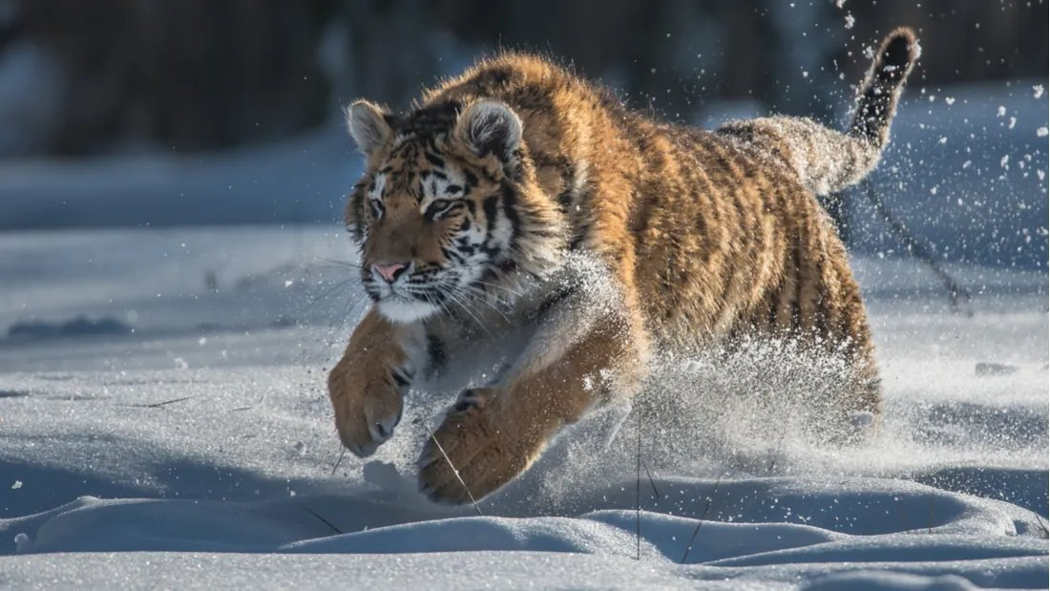
ITAI 1370 – Artificial Intelligence Lecture 2: AI Glossary Kickstart
Version 7.0
Team Tiger
Expert
Systems
AutoML
Intelligent Robotics and Vision Systems
Fuzzy
Logic
IoT and Intelligent Distributed Agents
Artificial
Intelligence
Machine
Learning
Machine Learning in Chips and Hardware
Neural
Networks
AI Agents
Intelligent City

Slide 2
AI Agent
An AI Agent is a software system that can perceive its environment, make decisions, and take actions to achieve a goal. Unlike a traditional program that only follows fixed instructions, an AI agent can adapt its behavior based on new information.
Four Basic Components of an AI Agent
Perception: Perceive the Environment
Example Camera, Microphone, and Sensors
Reasoning: Analyze Information
Example: Machine Learning Models
Decision Making: Select the Best Action
Example: Choose the Fastest Route
Action: Perform Task
Example: Drive, Answer a Question, and Send an email
Real World Example: Self-Driving Car
The Smart Car detects roads, pedestrians, plans a route, and control steering, braking, and acceleration.
Goal: Safely Transport Passengers.

Slide 3
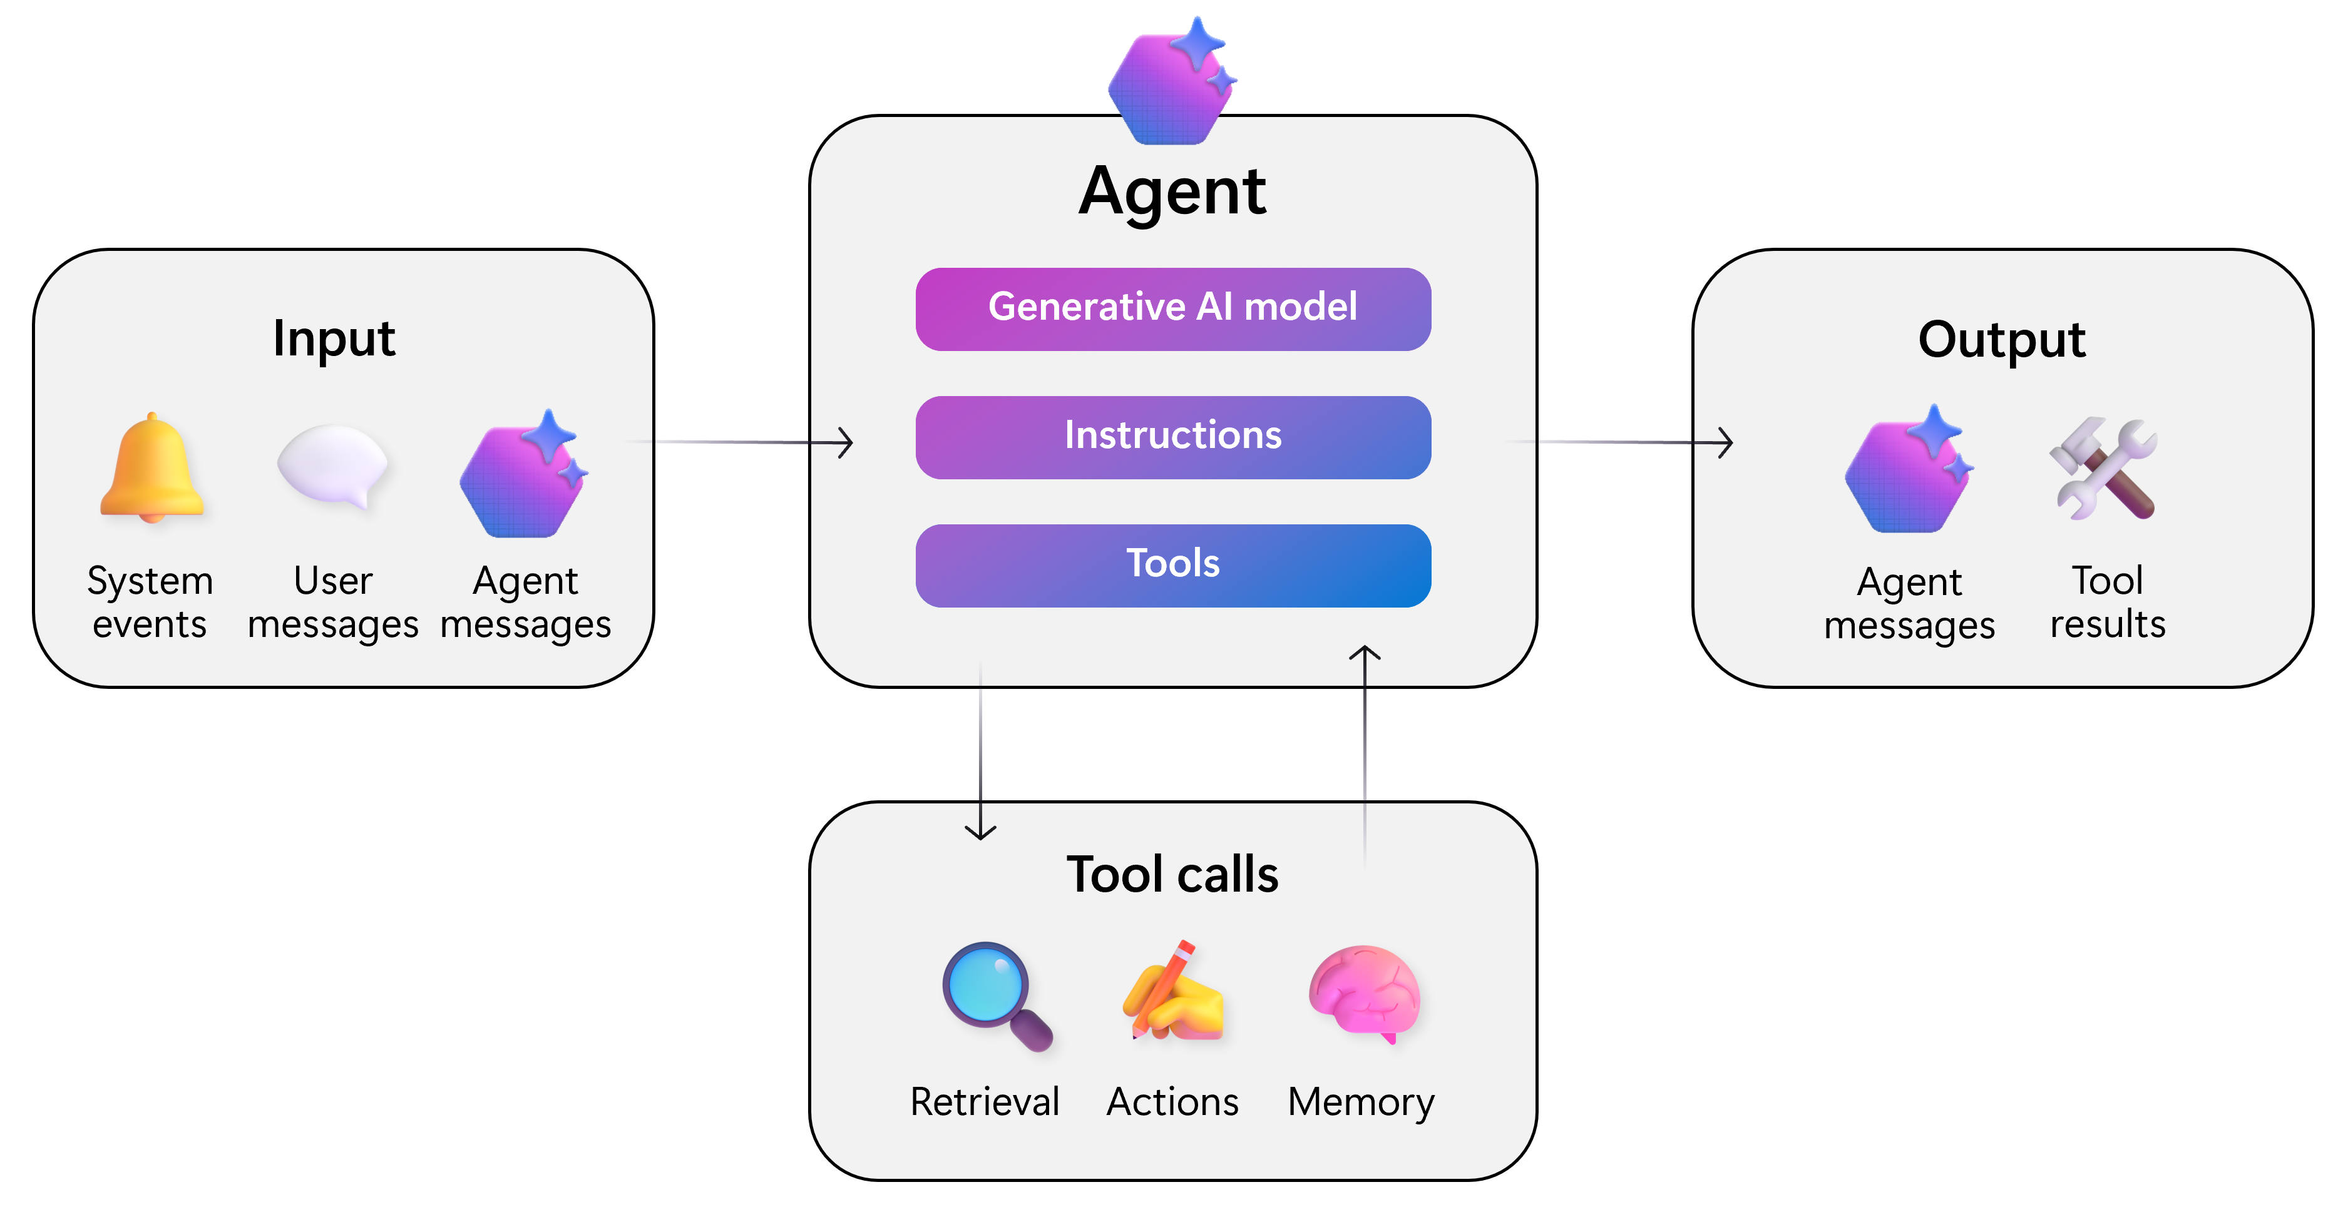
AI Agent

Slide 4
AutoML
AutoML (Automated Machine Learning)
AutoML automates data preprocessing, feature engineering, model selection, hyperparameter tuning, model evaluation, and deployment assistance.
How AutoML Works
Raw
Data
Data
Processing
Try Many ML
Algorithms Automatically
Hyperparameter Tuning
Cross
Validation
Compare
All Models
Best Model Selected
Make Prediction

Slide 5
Expert System
An Expert System is a type of Artificial Intelligence (AI) that imitates the decision-making process of a human expert in a specific field.
Classical expert systems rely on expert-defined IF–THEN rules rather than learning patterns from training data.
How Expert System Works
User
Answer Questions
Inference Engines
(Decision Making)
Use IF-THEN Rules
Knowledge Base
(Facts + Expert Rules
Recommendation and Decision
Example: Loan Approval Rules:
IF income > $50,000 AND credit score > 700 THEN
approve loan

Slide 6
Fuzzy Logic
Traditional digital logic uses only two values (0 or 1), while fuzzy logic allows degrees of truth between 0 and 1.
We must convert temperature from real value to fuzzy term like cold, warm, and hot and low, normal, and high for humidity and this process is called
Fuzzification.
The second phase is Rule Evaluation, where IF–THEN rules are applied.:
If Temperature is Warm Then
Fan = Medium
End If
If Temperature is Cold Then
Fan = Off
End If
The system might combine multiple rules if they apply.
The last process of Fuzzy Logic is Defuzzification that converts the fuzzy result into a crisp numerical output. .
Example
Fan Speed
0 = Off
25 = Low
50 = Medium
75 = High
100 = Maximum

Slide 7
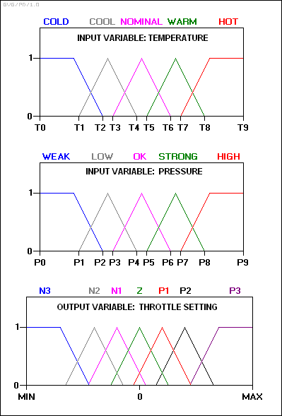
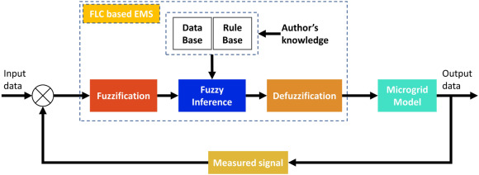
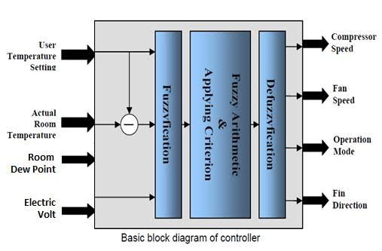
Fuzzy Logic

Slide 8
Intelligent City
The Core Pillars of an Intelligent City
IoT & Sensor Networks: Billions of internet-connected sensors embedded in pavement, water pipes, and buildings constantly feed raw data back to centralized platforms.
Intelligent Transit: Traffic lights that adjust dynamically based on real-time vehicle flow, smart parking apps that guide drivers to empty spots, and autonomous public transit fleets.
Predictive Infrastructure: Power grids that shift energy distribution automatically based on usage patterns, and water systems that pinpoint leak locations using acoustic sensors.
Data-Driven Decision Making: City planners use machine learning algorithms to run simulations on urban growth, disaster response, and public health trends
Smart Water: Leak detection, Smart water meters, and Flood monitoring
Environmental Monitoring: Air quality sensors, noise monitoring, weather stations, and pollution tracking., Noise monitoring , and Weather stations Pollution tracking
Smart Energy Smart electrical grid , that dim when no one is nearby Solar-powered infrastructure
Smart Transportation: Intelligent traffic lights , Real-time bus tracking, Smart parking, and Electric vehicle charging stations
Smart healthcare, Digital government, and Public safety

Slide 9
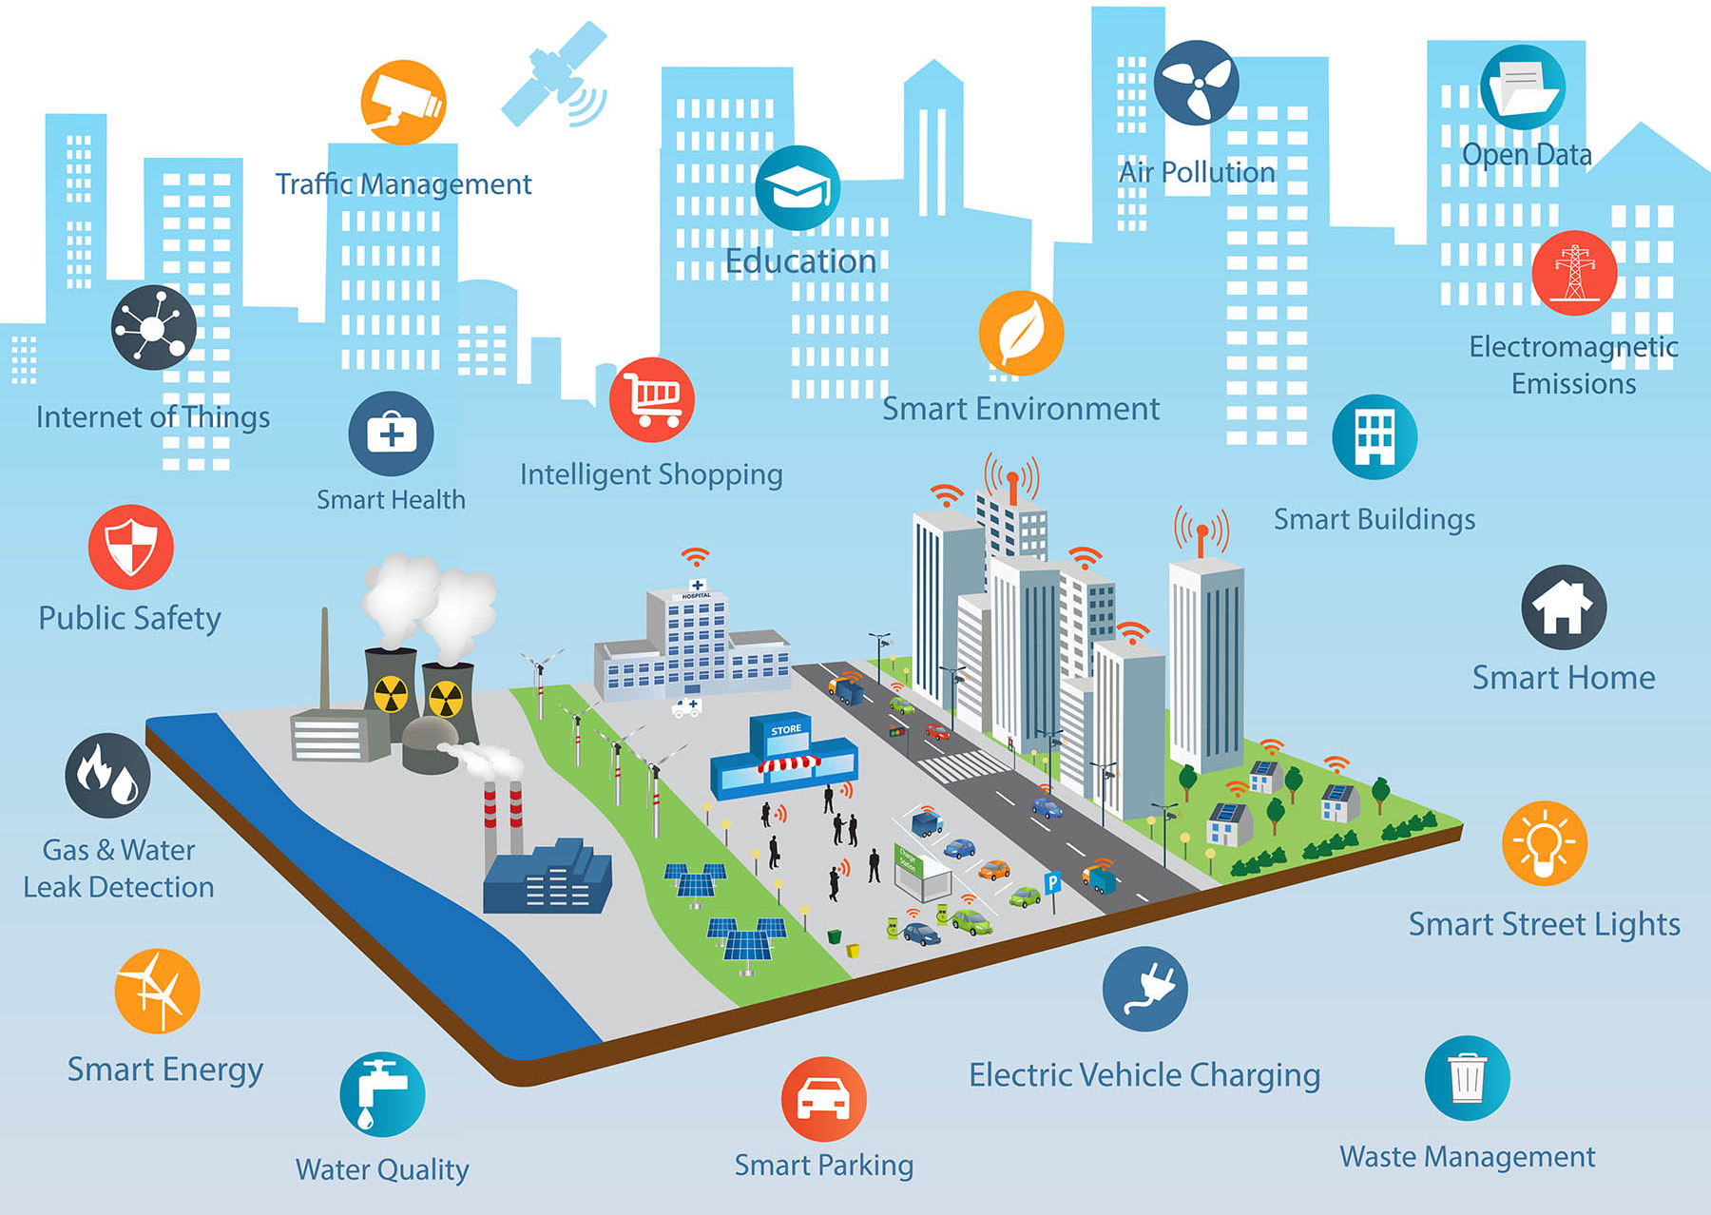
Intelligent City

Slide 10
Intelligent Robotic and Vision System
Main Components
Robot: The robot is the mechanical device that performs physical tasks.
Example: Industrial robot arm, Mobile robot, Drone, and Humanoid robot.
Vision System: The vision system acts as the robot's "eyes."
Example: Industrial robot arm, Mobile robot, Drone, and Humanoid robot.
Computer Vision: Computer vision processes the images and extracts useful information.
Example: Object detection, Face recognition, Barcode reading, Defect detection, Measuring object dimensions, and Motion tracking
Artificial Intelligence: AI acts as the robot's "brain.“.
Example: Object detection, Face recognition, Barcode reading, Defect detection, Measuring object dimensions, and Motion tracking
Controller: The controller coordinates all system components.
Example: Industrial robot arm, Mobile robot, Drone, and Humanoid robot.
Sensors: Additional sensors provide more information about the environment.
Example: Laser sensors (LiDAR), Ultrasonic sensors, Force sensors, Temperature sensors, Proximity sensors, and GPS (for outdoor robots)

Slide 11
Intelligent Robotic and Vision System
Applications
Manufacturing: Assembly, Welding, Painting, Quality inspection, and Packaging
Healthcare: Surgical robots, Medical image analysis, Rehabilitation robots, and Pharmacy automation
Agriculture: Crop monitoring , Fruit harvesting, and Weed detection, and Precision spraying
Transportation: Self-driving vehicles, Delivery robots, and Warehouse automation
Security: Face recognition, Surveillance, and Intruder detection
Service Industry: Hotel robots, Restaurant robots, Cleaning robots robots, and Customer assistance

Slide 12
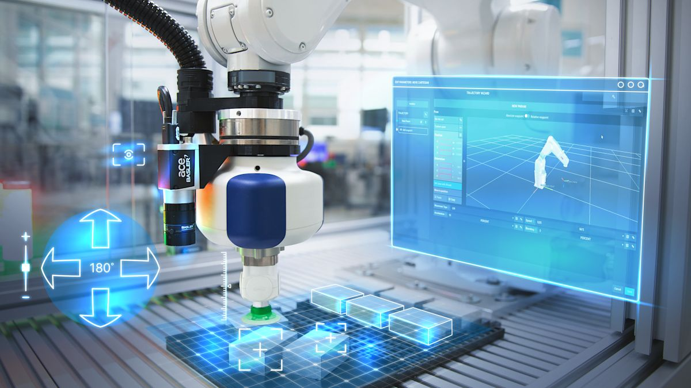
Intelligent Robotic and Vision System

Slide 13
IoT and Intelligent Distributed Agent
IoT (Internet of Things) and Intelligent Distributed Agents are two important technologies in modern Artificial Intelligence and distributed computing. Together, they enable smart environments such as smart homes, smart factories, autonomous vehicles, healthcare systems, and intelligent cities.
What is IoT (Internet of Things)?
The Internet of Things (IoT) is a network of physical devices connected to the Internet that can: Sense the environment, Collect data, Exchange information, Make decisions, and Perform actions automatically
These devices contain: Sensors, Actuators, Processors (microcontrollers), Communication modules (Wi-Fi, Bluetooth, Zigbee, 5G, and LoRa WAN)
What is a Distributed Agent?
A Distributed Agent is one of many intelligent agents working together across different computers or devices. Instead of one central controller: Each agent can make local decisions independently. , Agents communicate with one another, They cooperate to solve problems, and The system continues working even if one agent fails.

Slide 14
IoT and Intelligent Distributed Agent
Relationship Between IoT and Intelligent Distributed Agents
IoT | Intelligent Distributed Agents
Collects data | Analyzes data
Connects devices | Makes decisions
Uses sensors | Uses AI algorithms
Sends information | Coordinates actions
Provides communication | Provides intelligence
Think of it this way:
IoT provides the eyes, ears, and communication (sensors and networks).
Intelligent Distributed Agents provide the brain and teamwork (AI decision-making and coordination).

Slide 15
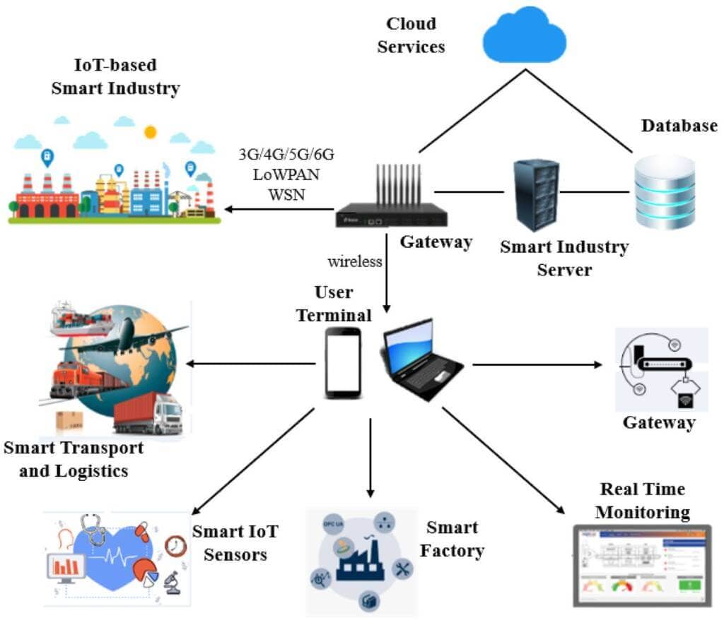
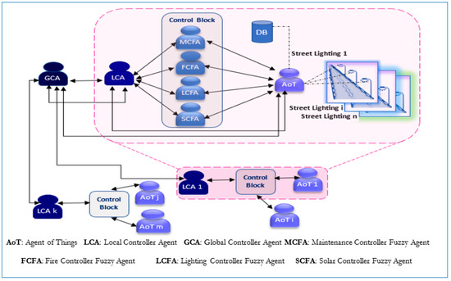
IoT and Intelligent Distributed Agent

Slide 16
Machine Learning
Major Model of Machine Learning
Supervised Learning Supervised learning learns a mapping from labeled input data to output labels so it can accurately predict future outcomes.
Unsupervised Learning: Unsupervised learning uses unlabeled data to discover hidden patterns or group similar data. and let the model to figure out by itself.
Reinforcement Learning: It is trial and error like teaching a dog by giving food for good manner and etc.
Machine Learning Process or Pipeline
First, collect data from a real-world application or a random generator.
Next, clean the data by removing duplicate rows, outliers, and empty values, and apply feature engineering to improve it.
We use models such as Linear Regression, Clustering, and Logistic Regression to map input to output.
Let the model learn from data, that dim, and tune it to produce metrics such as accuracy.
We can use AutoML to automate all the above processes; an expert human must monitor for safety and ethical considerations.

Slide 17
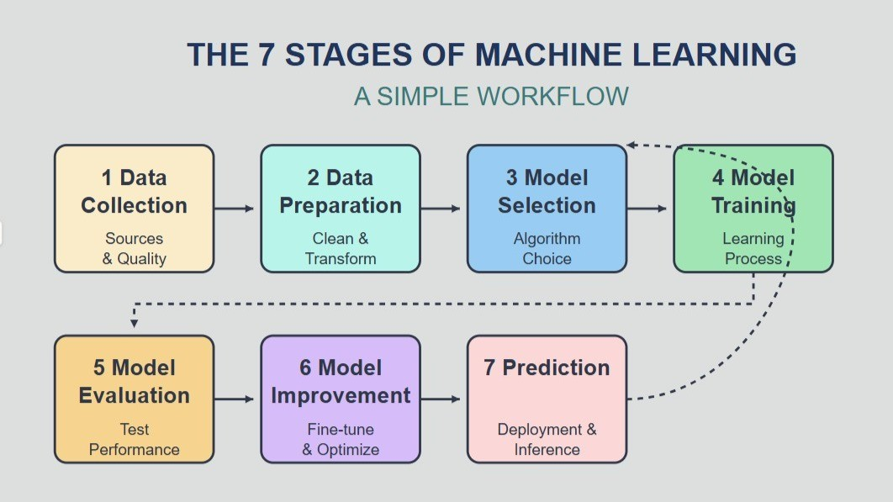
Machine Learning

Slide 18
Machine Learning in Chip or Hardware
Machine Learning in chips or hardware refers to designing computer hardware that can run machine learning algorithms efficiently, often with lower power consumption and much higher speed than a general-purpose CPU.
CPUs are commonly used for data preprocessing, software development, and inference for smaller models. and software development and inference.
Example AMD Ryzen 9 9950X and Intel Core Ultra 9
GPU is used for deep learning,, image recognition, large language model, and Video AI.
Example: NVIDIA GeForce RTX 5090
TPU is specialized processors optimized for TensorFlow and large-scale matrix operations.
Example: Google Search, Google Translate, Gemini, and Image Recognition
FPGA is used in Medical Equipment, Radar, Industrial Robots, and Network Devices
ASIC is used in Extremely Fast and Very Energy Efficient
Example: Smartphone AI processor, Bitcoin Mining Chip, and AI accelerator for Data Centers.
AI Hardware Architecture Process.
Sensor, AI Chip, Neural Network, and Prediction are process or flowchart of AI Hardware Design.

Slide 19
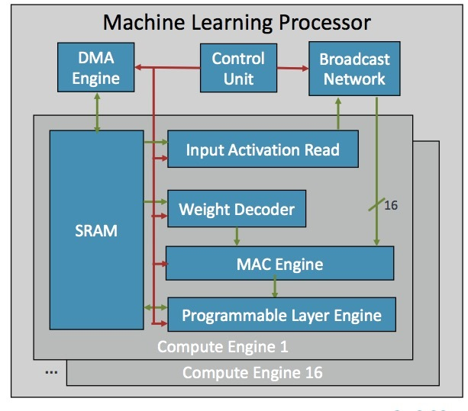
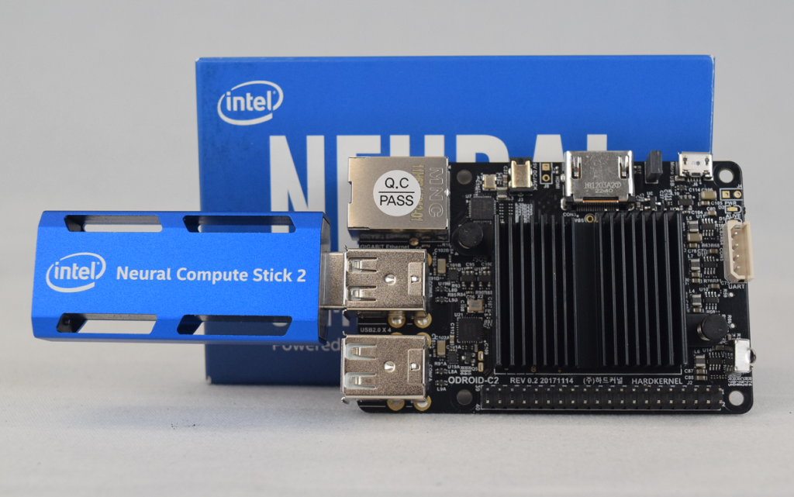
Machine Learning in Chip or Hardware

Slide 20
Neural Network
Neural Network
A Neural Network (NN) is a machine learning model inspired by the way the human brain processes information. It consists of interconnected processing units called neurons that work together to recognize patterns, make predictions, and solve complex problems.
Simple Definition
A neural network is a computer model that learns from examples by adjusting connections between artificial neurons to improve its predictions over time.
Comparing Traditional Machine Learning To Neural Network
Traditional Machine Learning | Neural Network
Often requires manual feature engineering | Learns features automatically
Works well with smaller datasets | Usually performs better with larger datasets
Faster to train | Slower to train
Easier to interpret | Harder to interpret
Lower computational cost | Higher computational cost

Slide 21
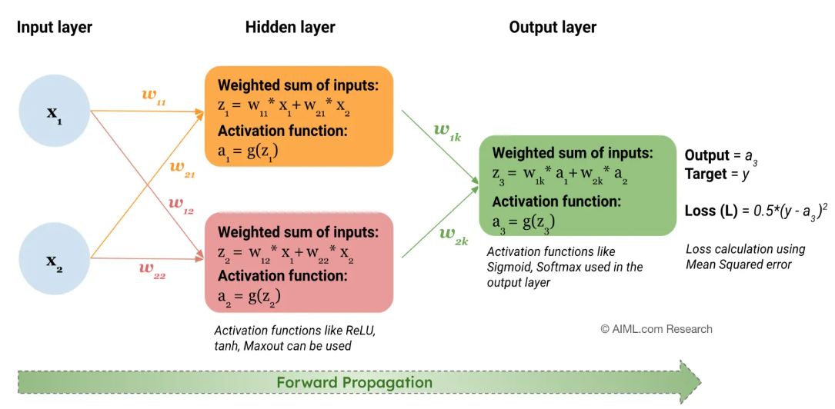
Neural Network
Forward propagation in a Neural Network

